Slide 1
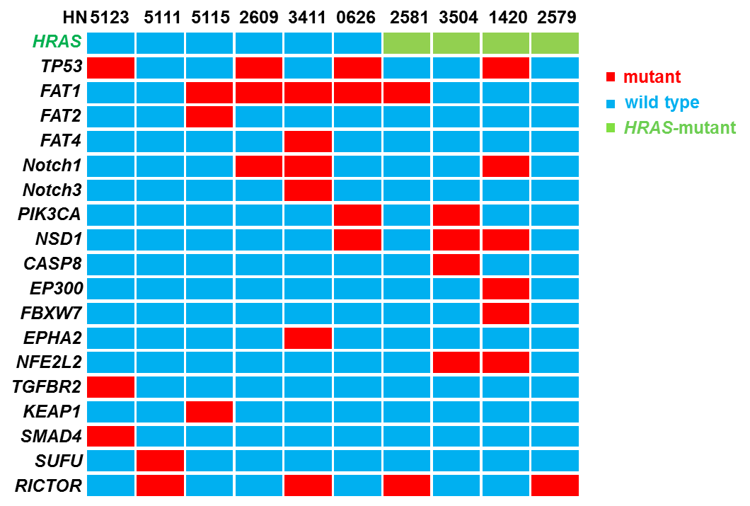
Supplementary Figure 1.
Mutational signatures of HNSCC PDX models
A
B
Tipifarnib is inactive in HRAS wild type HNSCC PDX models
Tumor volume (mm³)
Treatment day
Change in tumor volume
C
200
150
HRAS wild type
100
HRAS-mutant
Change in tumor volume(%)
50
* Capped at 200%. Actual values 208-597%
0
-50
-100

Slide 2
Supplementary figure 1. Antitumor activity of tipifarnib in HRAS WT patient-derived xenograft models. (A) Mutational signatures of HNSCC PDX models. The mutational status of the genes most frequently mutated in HNSCC in the human PDXs used for the current study is depicted. (B) PDX models lacking HRAS mutations. HN2609, HN0626, HN2590, HN5111, HN5115 and HN5123 fragments were implanted in nude mice and treated with vehicle or tipifarnib (60mg/kg PO BID) as indicated. (C) Change in tumor volume for each single mouse used for PDX model study.

Slide 3
Supplementary Figure 2. Advaita gene set enrichment analysis
A. Cell cycle
B. Epithelial cell differentiation
Supplementary figure 2. Advaita gene set enrichment analysis. Effect of tipifarnib treatment on genes involved in (A) cell cycle progression and (B) epithelial cell differentiation in PDX models using Advaita GSEA (http://www.advaitabio.com/ipathwayguide)

Slide 4
Supplementary figure 3. ENRICHR gene set enrichment analysis
Supplementary figure 3. ENRICHR gene set enrichment analysis.

