Slide 1
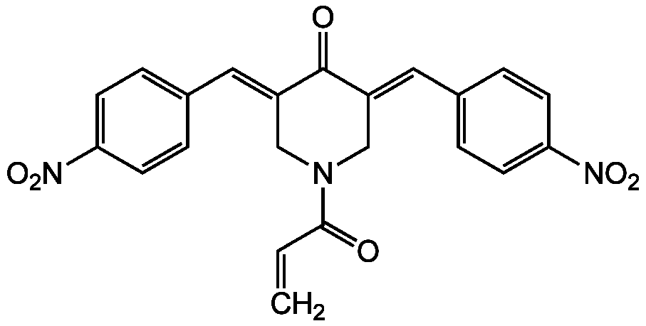
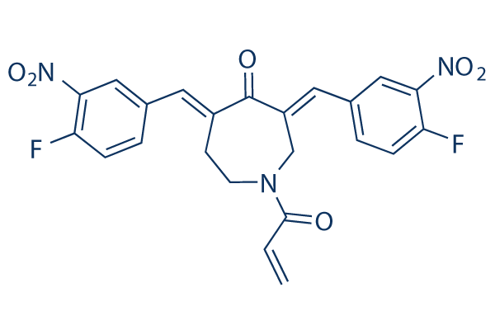
Supplementary Figure 1
A
no probe
0.2
0
0.5
1
2
b-AP15 (µM)
170
130
95
70
HA
55
43
60
USP14
37
UCHL5
110
USP5
130
USP7
55
Tubulin
A375
B
C
b-AP15
b-AP15 (µM)
VLX1570 (µM)
HA-Ub-VS probe
-
-
-
-
-
+
0.5
-
+
2
-
+
-
0.5
+
-
2
+
USP14 -
HA
60
Ub
USP14
UCHL5 -
HA
Ub
VLX1570
37
UCHL5
40
ERK2
A375

Slide 2
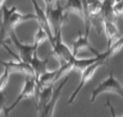
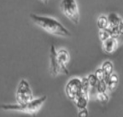
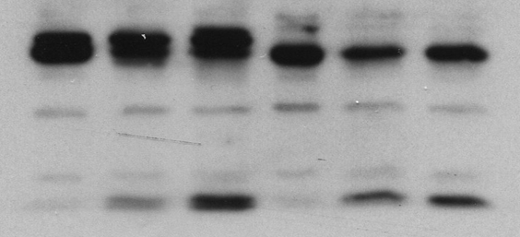
Supplementary Figure 2
A
B
DMSO
b-AP15
100
501Mel
501Mel
80
DMSO
Confluence (%)
b-AP15
60
VLX1570
40
BTZ
A375
20
0
Time (h)
C
501Mel
D
A375
DMSO
DMSO
Cytotoxicity (UA)
b-AP15 0.5µM
Cytotoxicity (UA)
b-AP15 0.5µM
b-AP15 2µM
b-AP15 2µM
VLX1570 0.5µM
VLX1570 0.5µM
VLX1570 2µM
VLX1570 2µM
Time (h)
Time (h)
E
F
A375
501Mel
0
24
1
0
24
1
b-AP15 (h)
110
PARP
Confluence (%)
85
Cleav. PARP
DMSO
35
Caspase 3
b-AP15 1h
Cleav.
Caspase 3
b-AP15 24h
19
55
Tubulin
Time (h)
A375
501Mel

Slide 3
Supplementary Figure 3
A375
Ad-CMV
Ad-USP14-Flag
USP14-Flag
USP14
Cleaved PARP
ERK2
-
+
-
+
b-AP15 (2 µM)

Slide 4
Supplementary Figure 4
A
B
A375
501Mel
siCtrl
siUSP14 (Pool)
siCtrl
Confluence (%)
siUSP14 #2
USP14
Tubulin
siUSP14 (pool)
siCtrl
Time (h)
C
501Mel
siCtrl
siUSP14 (Pool)
USP14
Tubulin
siCtrl
siUSP14 (pool)

Slide 5
Supplementary Figure 5
A
B
DMSO
b-AP15
H2O2
QVD pre-treatment
DMSO
QVD pre-treatment
+ b-AP15
NAC
A375
A375

Slide 6
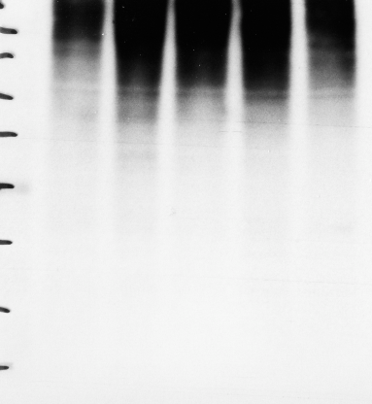
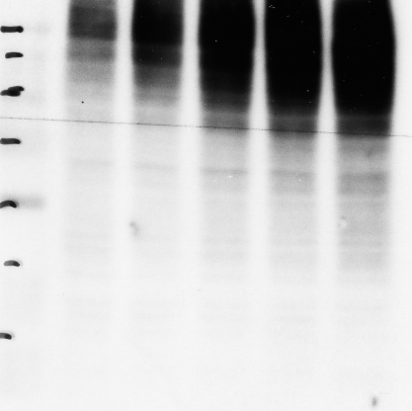
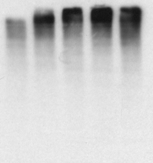
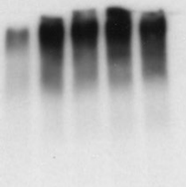
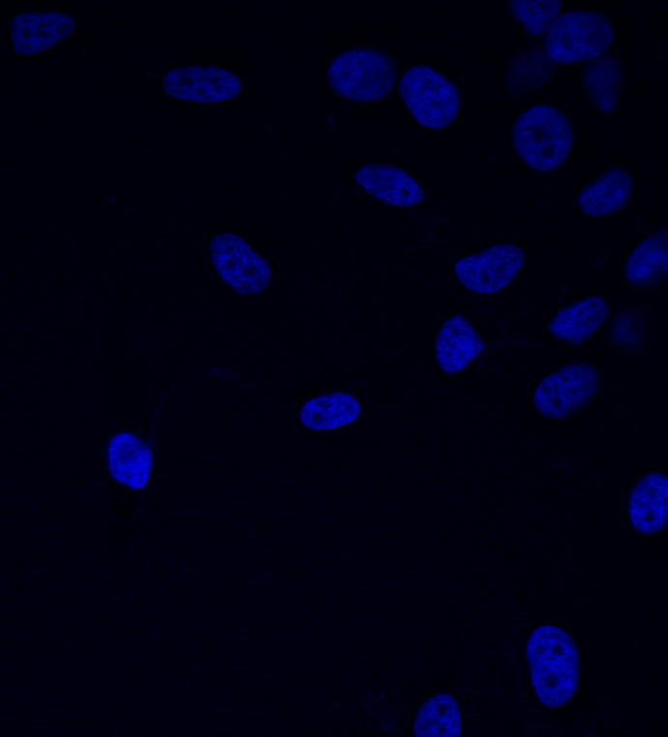
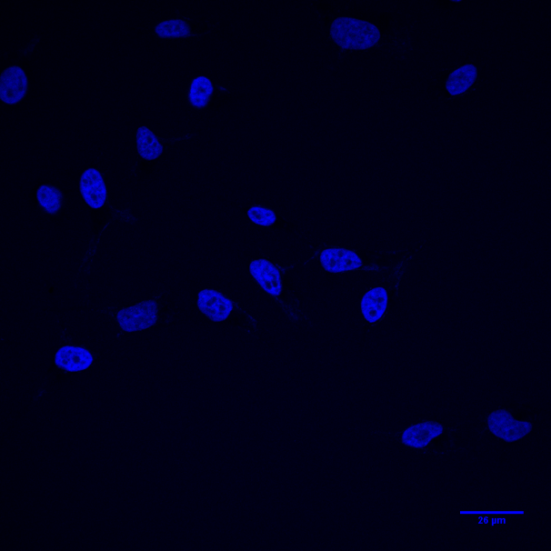
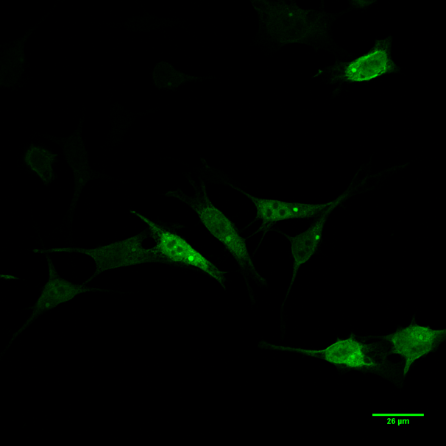
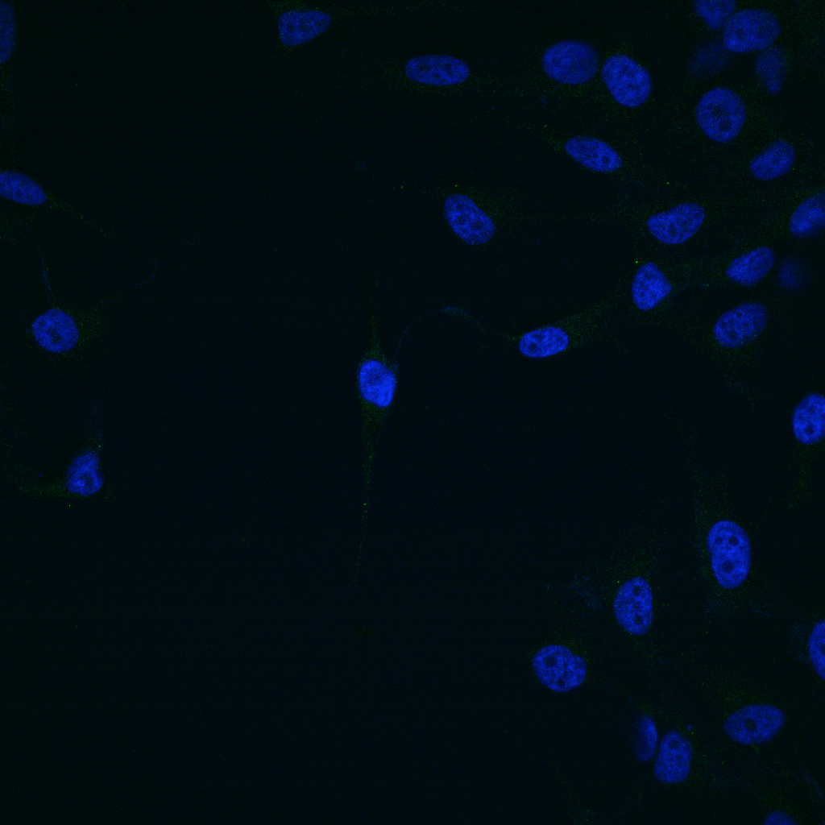
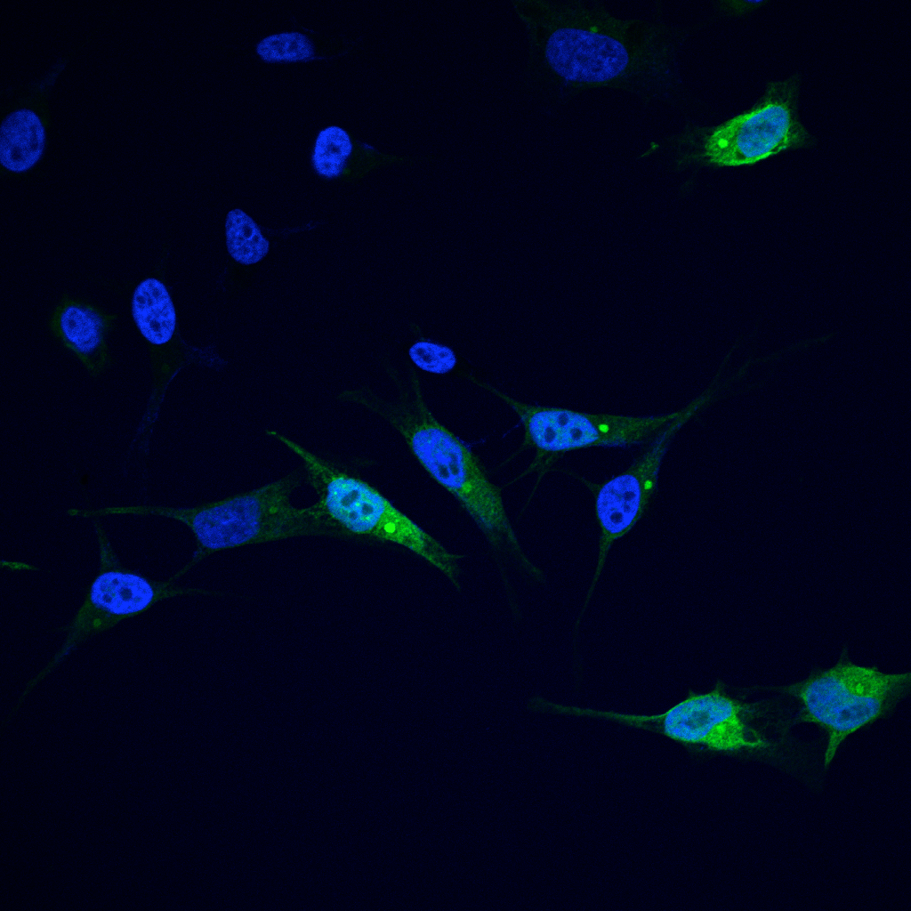
Supplementary Figure 6
A
0
1
3
6
24
0
1
3
6
24
0
1
3
6
24
0
1
3
6
24
b-AP15 (h)
180
130
Poly-
K48-Ub
90
70
55
40
40
ERK2
501Mel
A375
WM164
Pt#2
B
0
5
15
30
45
60
0
5
15
30
45
60
b-AP15 (min)
180
Poly-
K48-Ub
130
100
70
40
ERK 2
501Mel
1205lu
C
D
DMSO
b-AP15
0
1
3
6
24
0
1
3
6
24
0
1
3
6
24
b-AP15 (h)
180
DAPI
130
90
70
55
Poly-
K63-Ub
40
HSP70
35
40
ERK2
501Mel
1205lu
A375
Merge

