Slide 1
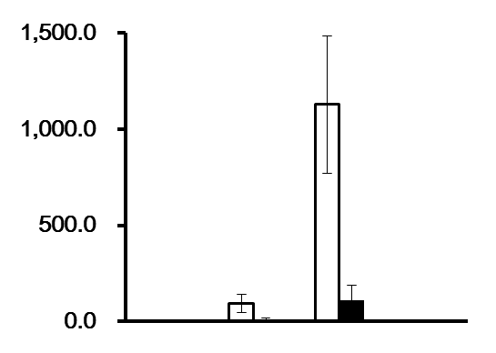
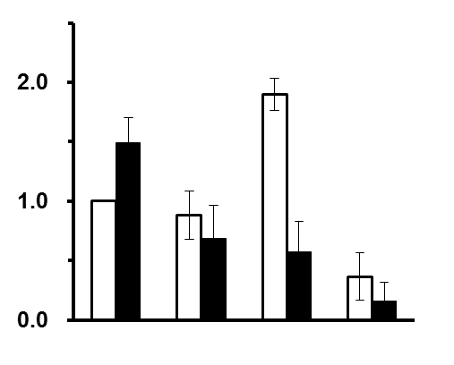
Supplementary Figure S3
A
1.5
ECT2
Vav3
2.0
1.0
mRNA expression level
1.0
0.5
0
A172
U87
T98G
U251
0
A172
U87
T98G
U251
B
8.0
4.0
integrin α2
integrin α3
6.0
3.0
mRNA expression level
2.0
4.0
2.0
1.0
0
0
2.0
integrin α5
2.0
integrin αV
mRNA expression level
1.0
1.0
0
0
2.0
integrin β1
3.0
integrin β3
mRNA expression level
2.0
1.0
1.0
0
0
A172
U87
T98G
U251
4.0
integrin β8
3.0
DMSO
mRNA expression level
AR-A014418
2.0
1.0
0
A172
U87
T98G
U251
Chikano Y, et al.

