Slide 1
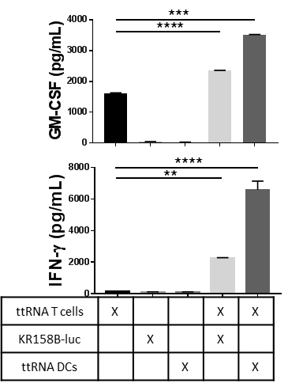
A
B
Supplementary Figure 6. T cell recognition of cognate antigen drives release of soluble factors including IFN-γ and GM-CSF. A). Bar graph represents ELISAs of supernatants from co-culture restimulation assay. T cells release GM-CSF with and without antigenic target cells and release IFN-γ only upon recognition of target. Experiment performed twice. B). Bar graph represents IFN-γ ELISA of supernatants from co-culture restimulation assay. TC+B16F10OVA represents antigen-mismatch control, TC+ttRNA DC represents antigen-paired group. Performed in parallel with differentiation experiment in Supplementary Figure 5A. T cells release IFN-γ only upon recognition of antigen-specific targets. All data represent the mean +/-SD. *P<.05, **P<.01, ***P<.001, by unpaired students t test for in-vitro studies (n=3).

Slide 2
A
Supernatant transfer
Lin⁻ HSPCs
+ GM-CSF
Block ab.
+ IFN-γ
Block ab.
+ GM-CSF
&
+ IFN-γ
Block ab.
B
Supplementary Figure 7. T cell-released IFN-𝜸 and GM-CSF contribute to HSPC differentiation. A). Bar graph represents data from supernatant transfer experiment in which TCs with antigen-specific target were co-cultured. Upon treating HSPCs with conditioned media, 25μg/mL blocking antibodies for IFN-𝜸 and GM-CSF were added to culture. Data demonstrates importance of IFN-𝜸 and GM-CSF in HSPC differentiation into DCs in-vitro. B). Bar graph represents data from ELISAs for IFN-𝜸, TNF-α, and GM-CSF on supernatants of T cell restimulation assays. T cells were either from WT, GM-CSF knockout, or IFN-𝜸 knockout animals. Data demonstrates that all three cell types are proficient at activating in response to antigen-matched target cells as evidenced by TNF-alpha release. Notably, the IFN-𝜸 knockout group has an abrogated IFN-𝜸 release while GM-CSF and WT T cells do not. Conversely, the GM-CSF knockout group has an abrogated GM-CSF release while the IFN-𝜸 knockout and WT T cells do not. Cells that had cytokine knockouts were appropriately deficient in their specific cytokine. All data represent the mean +/-SD. *P<.05, **P<.01, ***P<.001, by unpaired students t test for in-vitro studies (n=3).

Slide 3
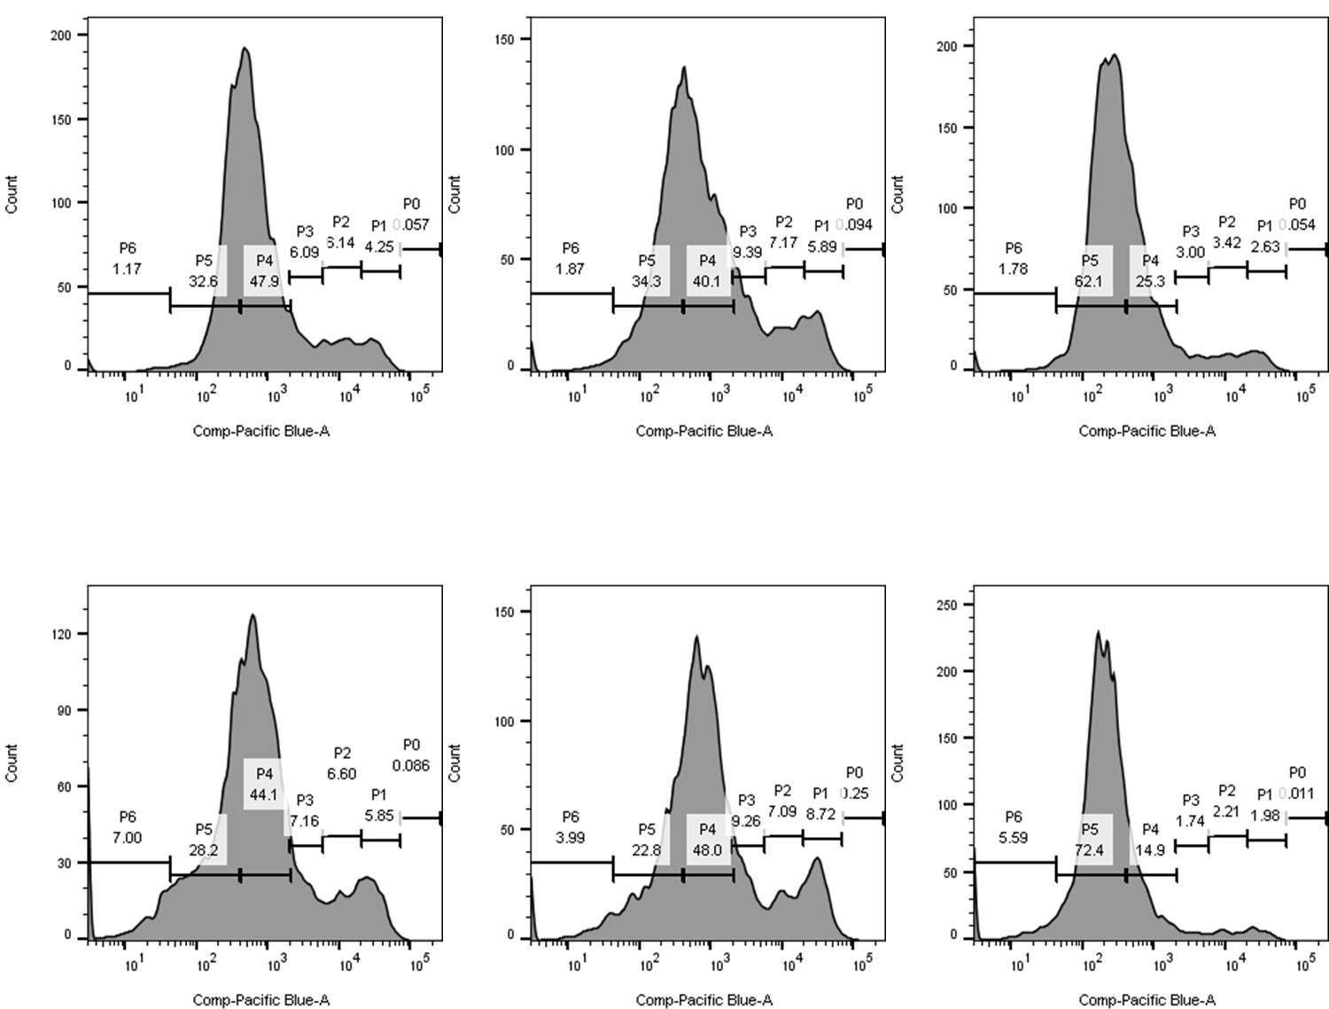
A
Supernatant transfer
B
Lin⁻ HSPCs
Lin⁻ HSPCs
T cells
GM-CSF KO
T cells
IFN-γ KO
T cells
ttRNA DC
T cells +
ttRNA DC
GM-CSF KO
T cells +
ttRNA DC
IFN-γ KO
T cells +
ttRNA DC
Culture 2d
Culture 3d
C
D
WT TCs
GM-CSF KO TCs
IFN-γ KO TCs
WT TCs +
ttRNA DCs
GM-CSF KO TCs
+ttRNA DCs
IFN-γ KO TCs
+ttRNA DCs
Supplementary Figure 8. Supernatant transfer with cytokine knockout T cells differentiates the roles of IFN-𝜸 and GM-CSF in HSPC differentiation and proliferation. A). Layout for supernatant transfer experiment that includes cytokine knockout T cells. B). Graphs plot total # of HSPC-derived cells per well on the x-axis while plotting the % expression of surface markers on the y-axis. MHC II expression is significantly diminished in TC+DC samples that are lacking IFN-𝜸. Meanwhile, CD11b⁺Ly-6G/6C⁺ co-expression is increased in samples that are lacking IFN-𝜸. C). Quantification of proliferation by total cell counts of cells per well from Supp. Fig. 8B. Note that GM-CSF KO TCs alone have a decrease in proliferation while all IFN-𝜸 KO groups have increased proliferation. D). Representative CellTrace Violet flow cytometry plots for groups of HSPCs treated with WT or cytokine knockout T cells. Graphs demonstrate gating strategy that is similar to Supp. Fig. 3, D-E. All data represent the mean +/-SD and all experiments were performed twice. *P<.05, **P<.01, ***P<.001, by unpaired students t test for in-vitro studies (n=3).

