Slide 1
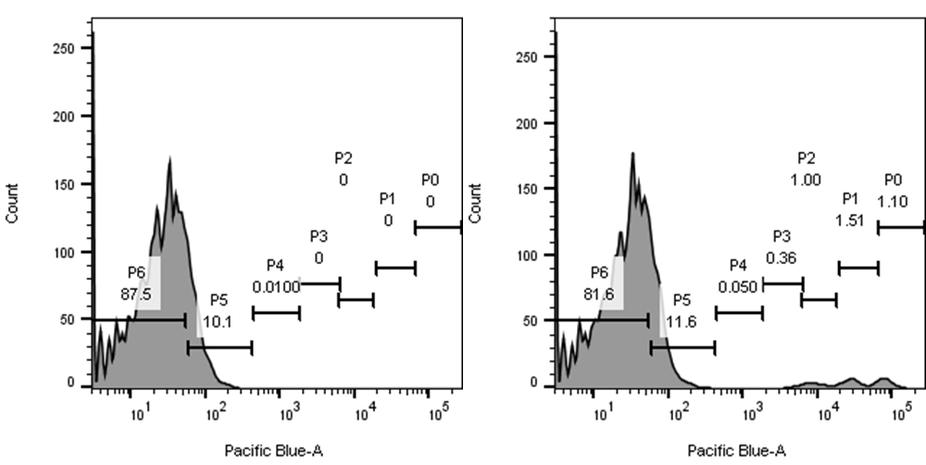
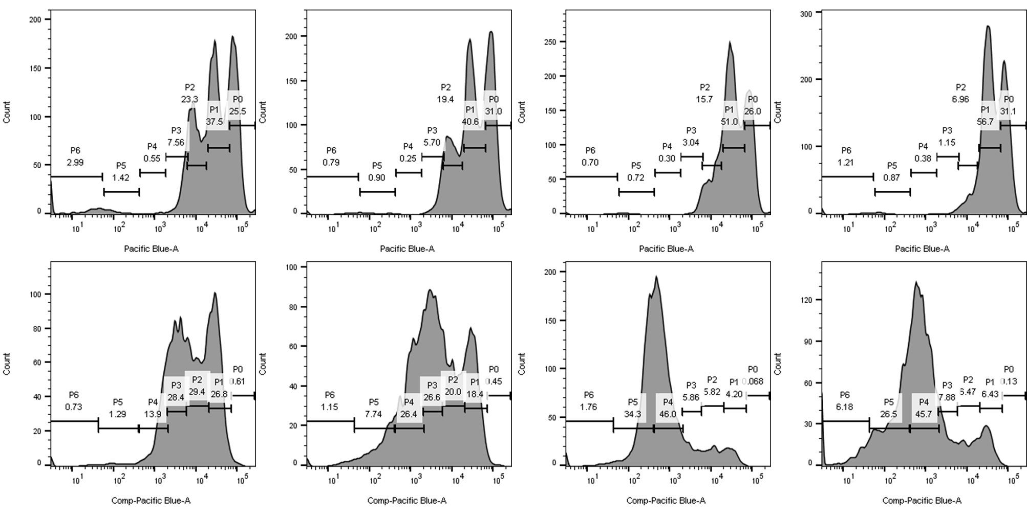
A
B
C
D
CTV-labeled HSPCs
+ unlabeled TCs
Unlabeled TCs
HSPCs alone
ttRNA DCs
TCs
TCs+ttRNA DCs
E
Day 1
Day 3
Supplementary Figure 3. HSPCs proliferate and differentiate into antigen-presenting cells in the presence of T cell-released soluble factors. A). Bar graph represents absolute count flow cytometry of total number of HSPC-derived cells per well after 3d of supernatant transfer conditioned media. P0-least proliferative population, P6-most proliferative population. Cells initially gated on CellTrace Violet population for bar graph. B-C). Bar graphs represents flow cytometry of HSPC-derived CD11c⁺MHCII⁺ cells and CD86⁺MHCII⁺ cells. Cells initially gated on CellTrace Violet population for bar graph. Data indicate that HSPCs proliferate and differentiate into CD11c⁺MHCII⁺CD86⁺ cells after treatment with supernatants from WT TCs+ttRNA DC co-culture. D). FACS Gating strategy for labeled/unlabeled population. Left is unlabeled T Cells, right is a mix of CTV-labeled HSPCs and unlabeled T cells. E). Gating strategy for dividing populations. Top row is HSPCs after 1 day of culture in conditioned media, bottom row is HSPCs after 3 days of culture in conditioned media. Conditioned media type is listed above each column. Population gates drawn based on early and late aggregation of cells within proliferative peaks. Experiment performed twice. All data represent the mean +/-SD. *P<.05, **P<.01, ***P<.001, ****P<.0001, by unpaired students t test for in-vitro studies (n=3).

