Slide 1
Supplementary Figure 1.
hinge
CH2
CH3
N
Human IL-7
156-185
186-
193
194-293
294-400
IgD
IgG4

Slide 2
Supplementary Figure 2.
*
Concentration (ng/ml)
*
*
Days after treatment

Slide 3
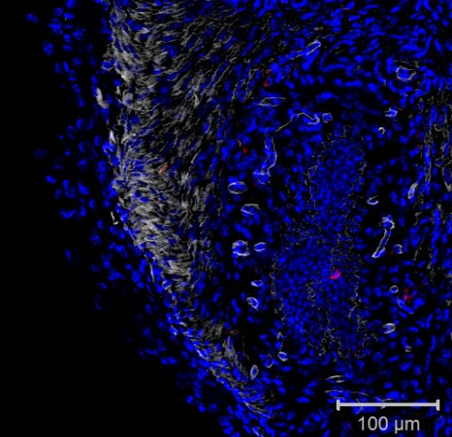
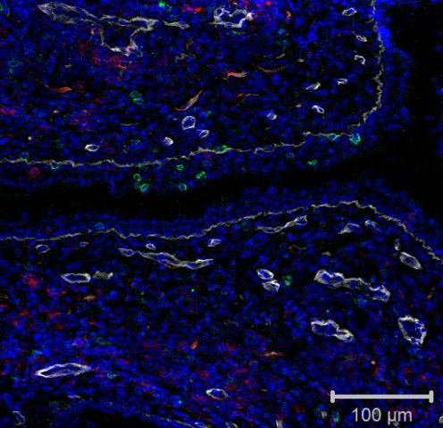
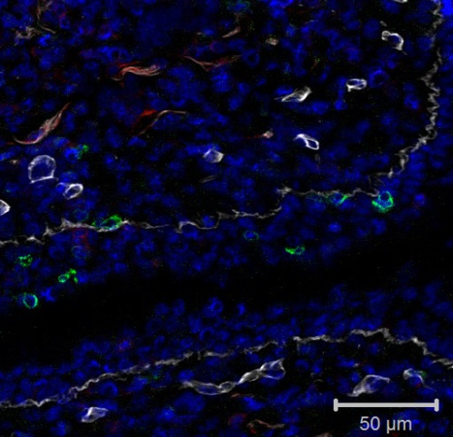
Supplementary Figure 3.
A
PBS
IL-7-Fc
LP
LP
1
LP
E
E
L
L
E
L
L: Lumen, E: Epithelial layer, LP: Lamina Propria
CD4 CD8 Collagen IV DAPI
B
**
PBS
**
PBS
IL-7-Fc
IL-7-Fc
No. of CD4⁺ T cells / mm²
( x 10 )
No. of CD8⁺ T cells / mm²
( x 10 )
**
n.s.
E
LP
E
LP
Notes:
(B) Bar graphs depicting quantitated CD4 (left) and CD8 (right) T cells in epithelium (EP) and lamina propria (LP). Data from bar graphs are means of 10 regions of interest (ROIs) quantitated per tissue compartment per subject.
Materials and methods
Quantitation of tissue immune cells in immunohistologic sections
CD4 and CD8 was quantitated by normalization against the area of the ROI (μm²).

Slide 4
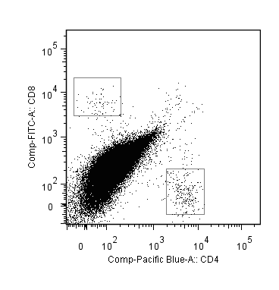
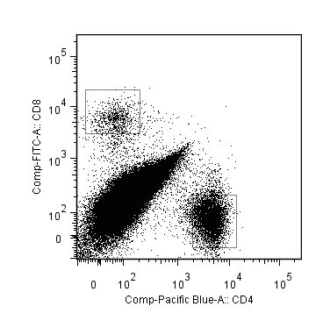
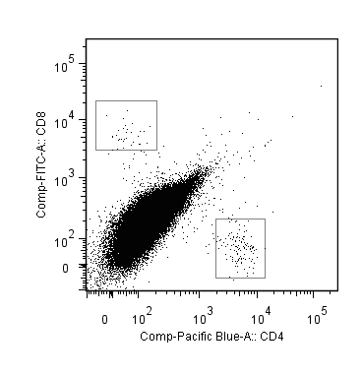
Supplementary Figure 4.
A
IL-7-Fc
Fc-fragment
PBS
10μg
10μg
50μg
0.02
0.50
0.03
0.02
CD8
0.05
1.58
0.06
0.05
CD4
B
**
**
**
**
No. of CD4⁺ cells in the CV
( x 10³ )
No. of CD8⁺ cells in the CV
( x 10³ )
PBS
10μg
10μg
50μg
PBS
10μg
10μg
50μg
IL-7-Fc
Fc-fragment
IL-7-Fc
Fc-fragment

Slide 5
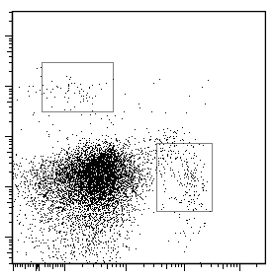
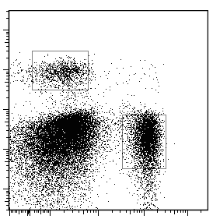
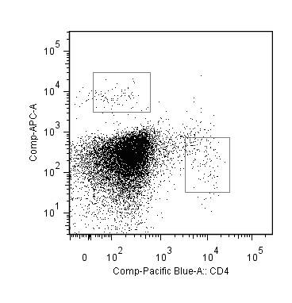
Supplementary Figure 5.
A
isotype
anti-IL-7Rα
PBS
IL-7-Fc
PBS
IL-7-Fc
0.04
0.40
0.03
0.03
CD8
0.06
1.25
0.05
0.06
CD4
B
**
**
No. of CD4⁺ cells in the CV
( x 10³ )
No. of CD8⁺ cells in the CV
( x 10³ )
PBS
IL-7-Fc
PBS
IL-7-Fc
PBS
IL-7-Fc
PBS
IL-7-Fc
isotype
Anti-IL-7Rα
isotype
Anti-IL-7Rα

Slide 6
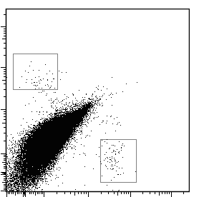
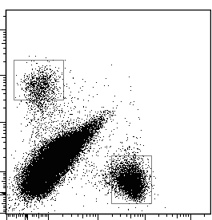
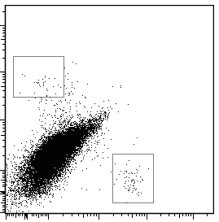
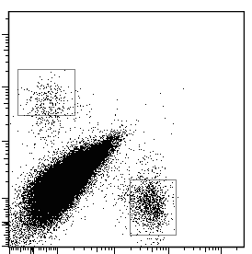
Supplementary Figure 6.
A
**
Concentration (ng/ml)
**
Days after treatment
B
IVAG
SC
PBS
IL-7-Fc
PBS
IL-7-Fc
0.02
0.49
0.03
0.11
CD8
0.04
1.78
0.05
0.34
C
CD4
**
**
No. of CD4⁺ cells in the CV
( x 10³ )
No. of CD8⁺ cells in the CV
( x 10³ )
PBS
IL-7-Fc
PBS
IL-7-Fc
PBS
IL-7-Fc
PBS
IL-7-Fc
IVAG
SC
IVAG
SC

