Slide 1
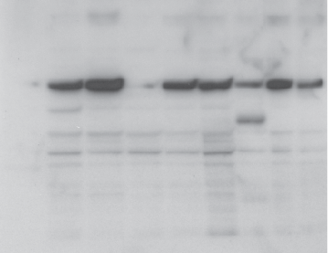
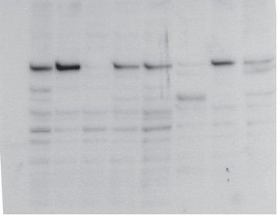
Immunoblot Score = 0; no changes
UPCC 02510-02-424
D1: 5/29/12
D57: 8/7/12
MN OK6 REN 208 213 302 307 M30 M60
MN OK6 REN 208 213 302 307 M30 M60
kD
kD
191
191
97
97
64
64
51
51
39
39
28
28
14
14

Slide 2
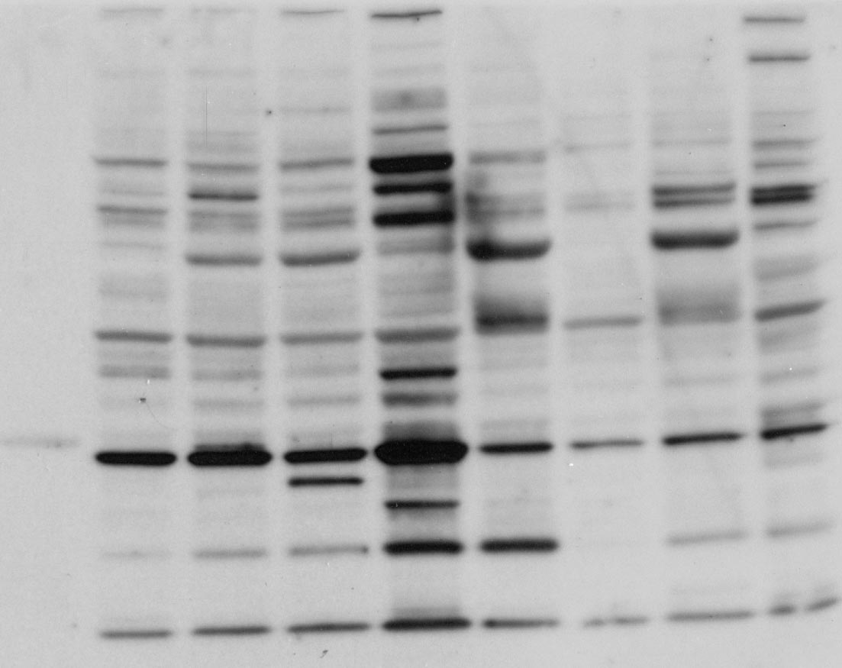
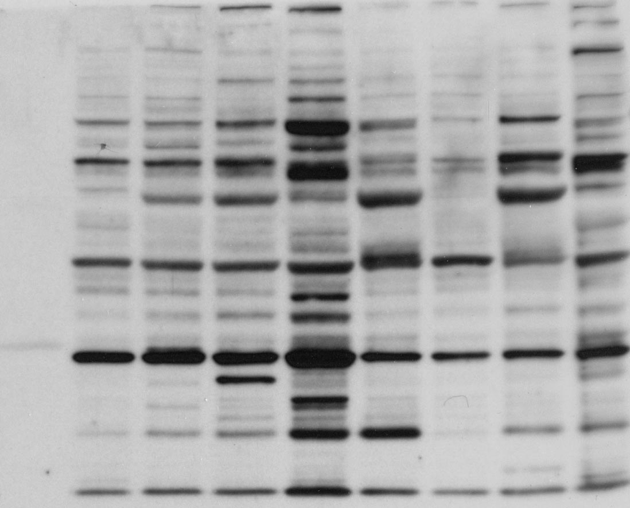
Immunoblot Score = 1; one increased band
Pt 430 day 1 Pt 430 Day 57
MN REN 208 213 302 307 M30 M60 OK6 MN REN 208 213 302 307 M30 M60 OK6
191kD
97kD
64KD
51KD
39KD
28KD
19KD
12- 24-2012-JS

Slide 3
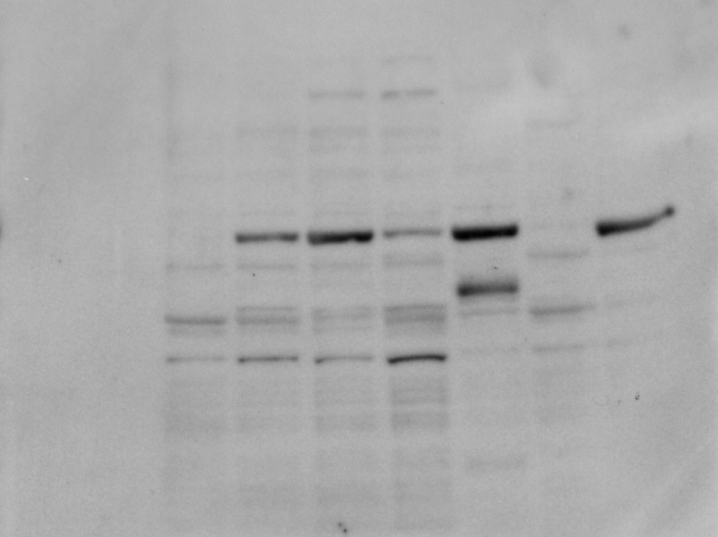
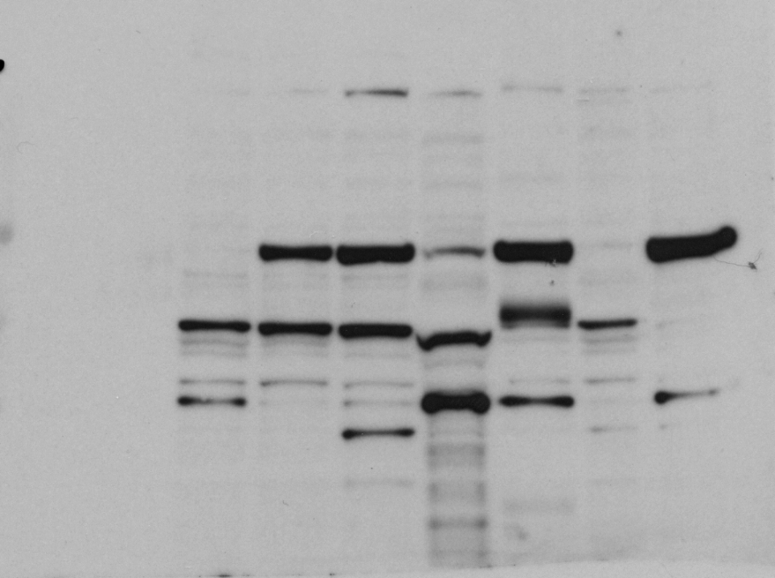
Immunoblot Score = 2; multiple strong new bands
Pt 422-Day 1 (5/21/2012)
Pt 422-Day 36 (6/25/2012)
kD
kD
MN SV REN 208 213 302 307 M30 M60
MN SV REN 208 213 302 307 M30 M60
191
191
97
97
64
64
51
51
39
39
28
28
14
14

Slide 4
Supplemental Figure 2

Slide 5
Supple Figure 3A

Slide 6
Supple Figure 3B

Slide 7
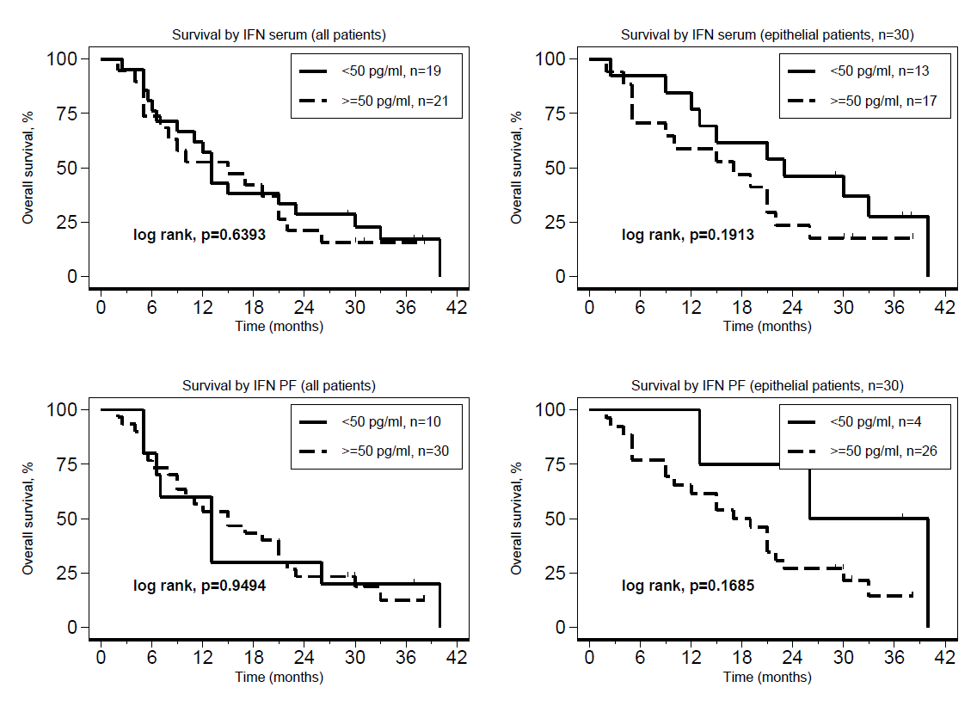
Supplemental Figure 3C. Association of survival with IFN levels in Serum or Pleural Fluid (PF)

Slide 8
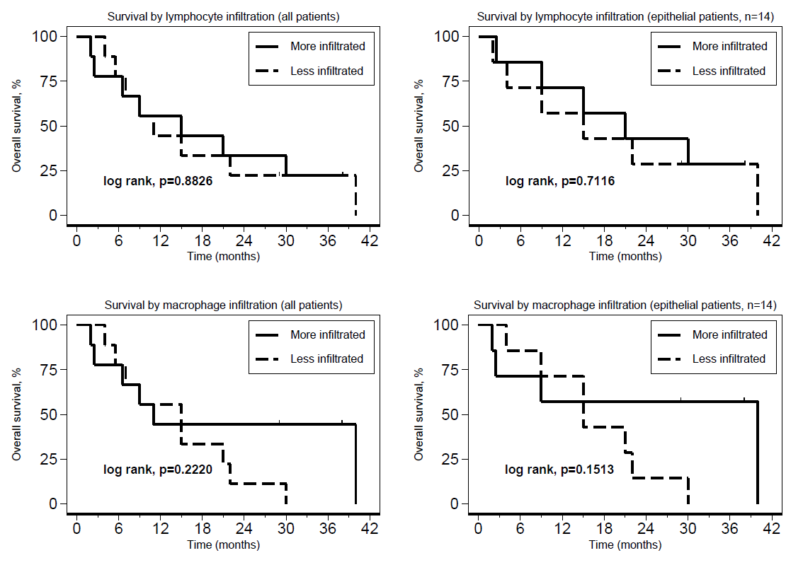
Suppl. Fig. 4. Lack of correlation of lymphocyte or macrophage infiltration rank vs survival
A
B

Slide 9
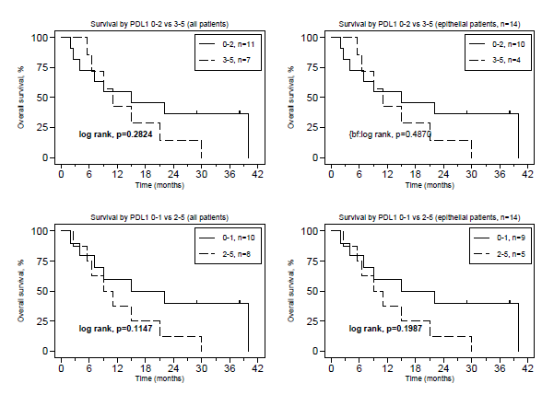
Suppl. Fig. 5. Lack of Correlation of PD-L1 staining vs MOS

Slide 10
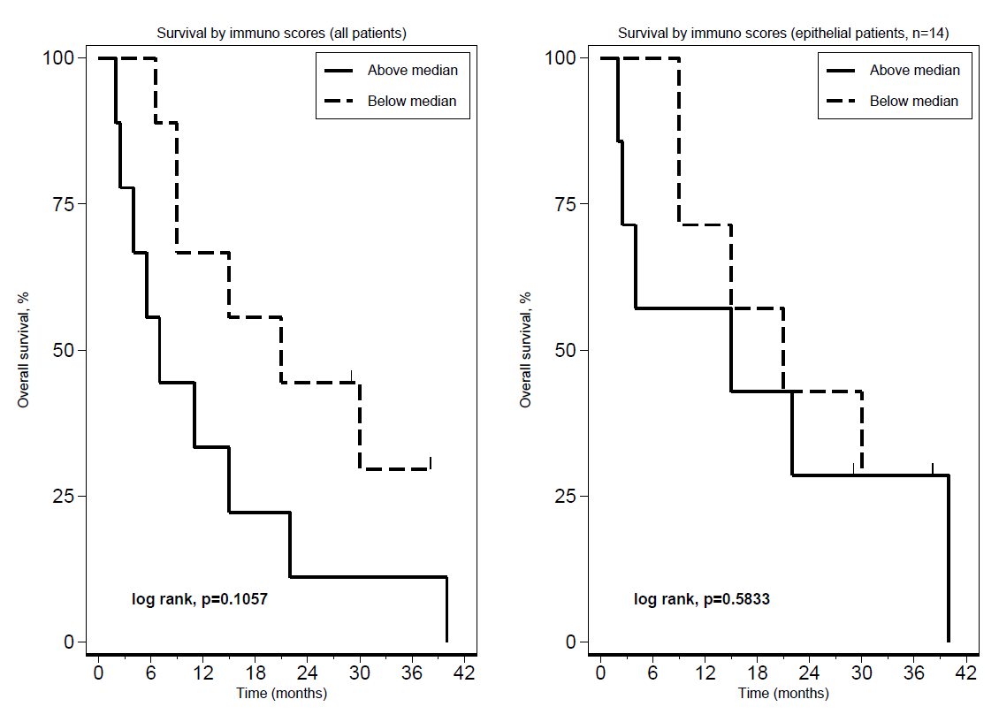
Suppl. Fig. 6. Correlation of Immunoscore rank vs MOS

