Slide 1
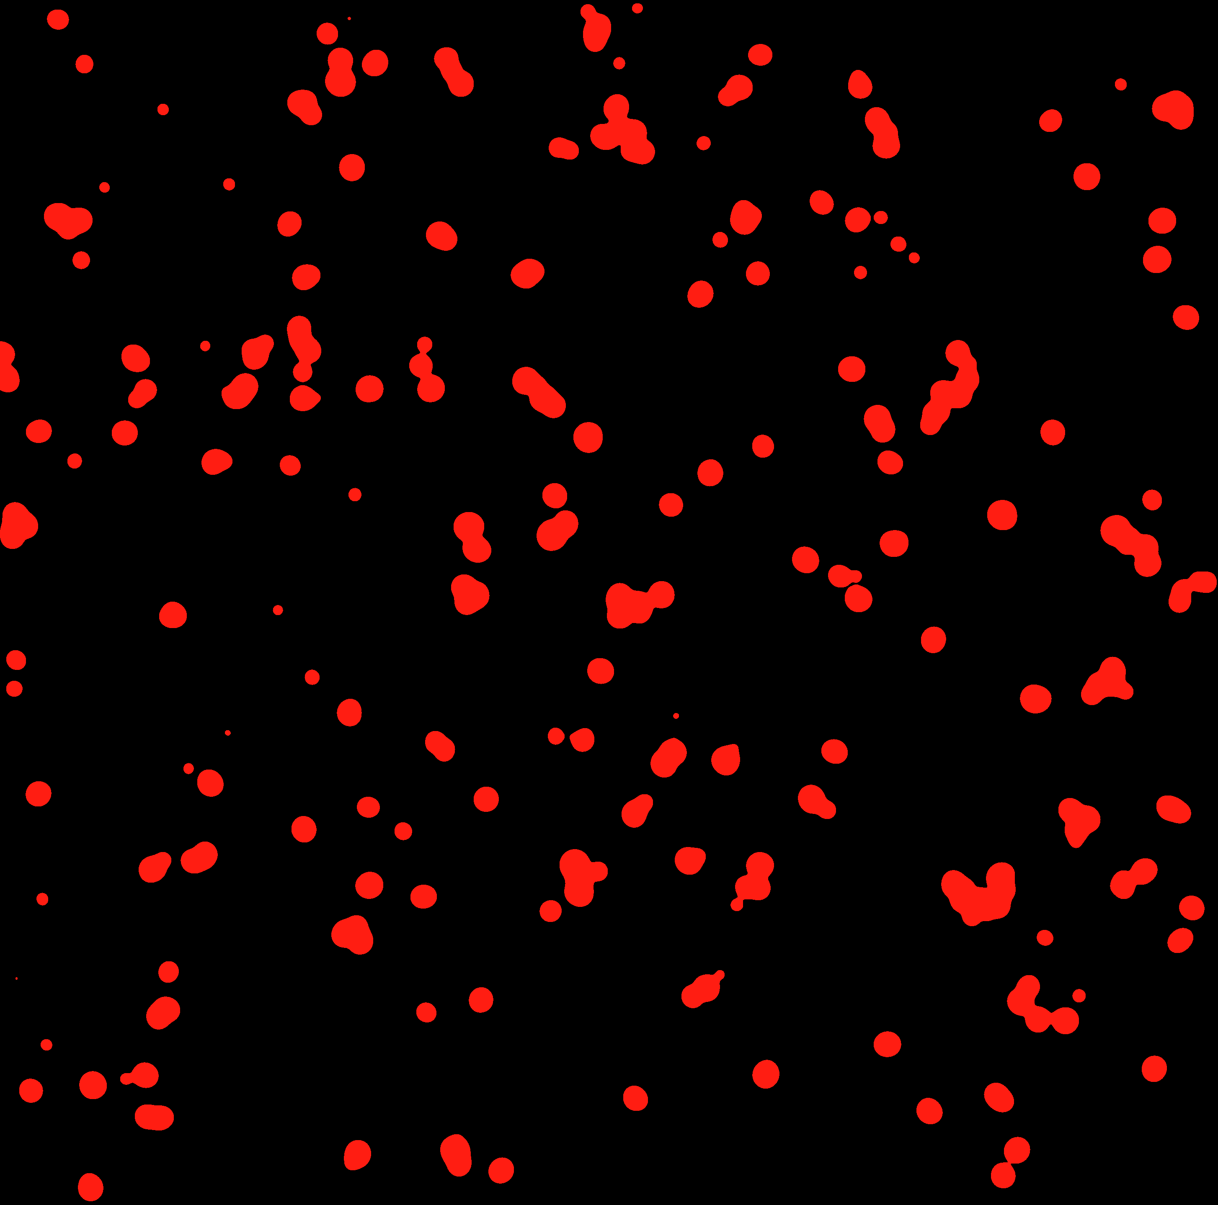
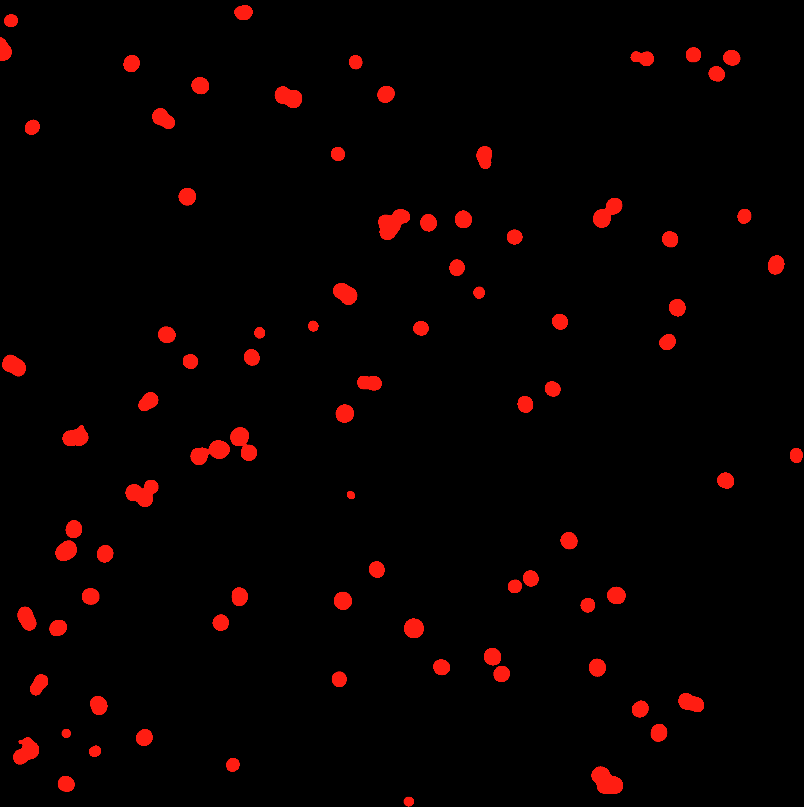
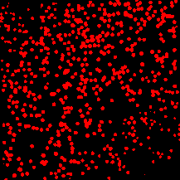
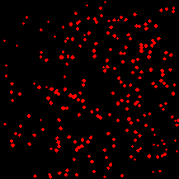
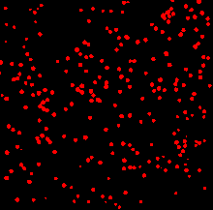
A
rE-cadherin-Fc
Vehicle
Sara
Vehicle
**
CD103⁺ CTL clone
Sara
0
50
100
150
B
Mean CTL per field
rE-cadherin-Fc
Vehicle
Sara
Actin
CD103⁺ CTL clone
Vehicle
***
Contrast
Sara
0
1
2
3
4
1.5
Mean CTL per field
C
1.0
CD8⁺/CD103⁺ T cells
Pxn/F-actin ratio
Sh-scram
0.5
Sh-pxn-1
Sh-pxn-2
Pxn
68 KDa
0.0
F-actin
42 KDa
***
Sh-pxn-1
Sh-pxn-2
Sh-scram
600
D
***
rE-cadherin-Fc
Sh-scram
Sh-pxn-1
Sh-pxn-2
400
Number of cells per field
CD8⁺/CD103⁺ T cells
200
0
Sh-scram
sh-pxn-1
sh-pxn-2
Supplementary Figure 1

