Slide 1
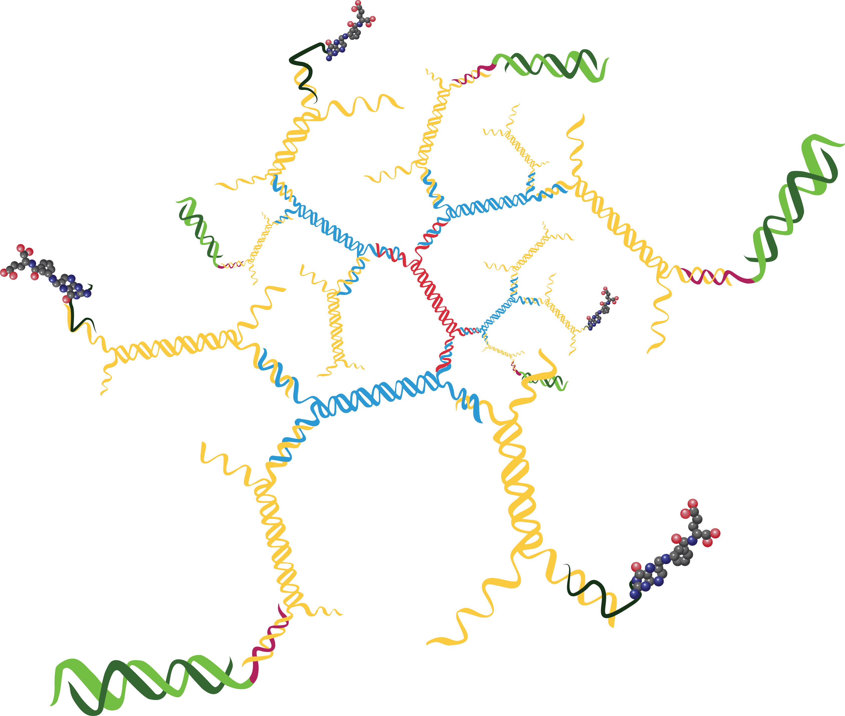
A
B
Therapeutic cargo
OVCA420
ID8-Fluc
Fluorescent tag
OVCAR3
OVCAR5
A2780
siHuR
Hio120
Tracking label
Folate
Receptor
1.0 2.2 1.4 2.5 2.3
GAPDH
2-layer 3DNA Core
C
siHuR Stability
Targeting/Internalization
Moiety
Folic acid
1
2
3
4
1 – 25 bp marker*
2 – PBS
3 – Serum free medium
D
4 – medium + 10% serum
Sense
Antisense
Supplementary Fig. S5. A. 3DNA® dendrimer platform for in vivo tumor-targeted delivery of siHuR.
B. Ovarian cancer cell lines, non-tumorigenic human immortalized ovarian epithelial cells
(HIO 80 and HIO 120), and murine ID8-Fluc cells express the folate receptor. C. Serum stability.
siHuR incubated for 1 hr at 37ºC, then assayed on a 10%Tris/Borate/Urea PAGE. Sense strand:
42 bases (modified bases + extension); Antisense strand: 22 bases (modified bases). D. In vitro
siHuR knockdown activity. siHuR (13nM) was combined with lipofectamine or targeted 3DNA
dendrimer and incubated with A2780 cells overnight in 10% serum-containing medium. Dendrimer
plus a scrambled siHuR had no knockdown activity (not shown).

