Slide 1
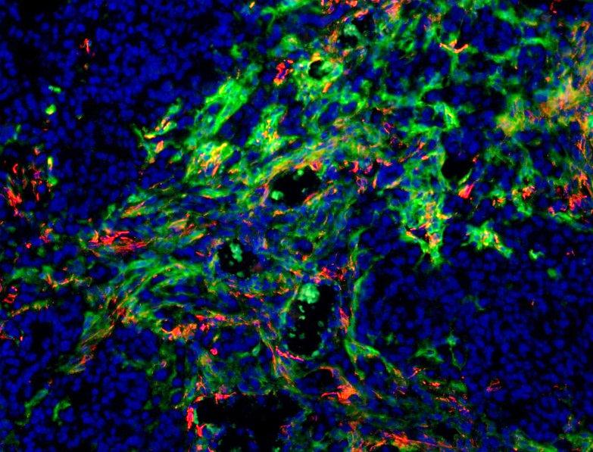
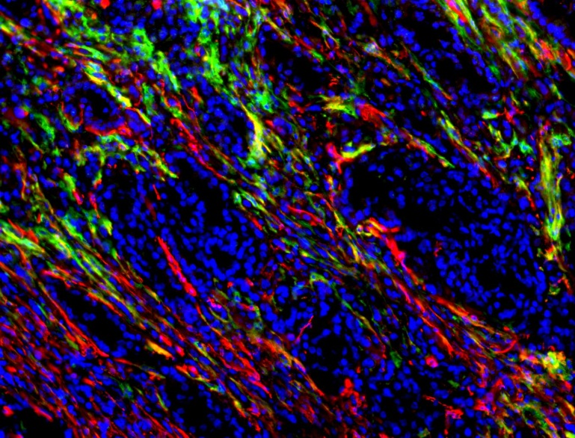
A
FAP
B
F4/80⁺ CD206⁺
F4/80⁺ CD206⁻
CD90⁺
NSG
FAP^{+/+}
CD45⁻
CD45⁺
NSG
FAP^{-/-}
FAP
Isotype control
Anti-FAP
C
FAP SMA DAPI
Isotype
D
CD90⁺
Supplementary Figure 1

