Slide 1
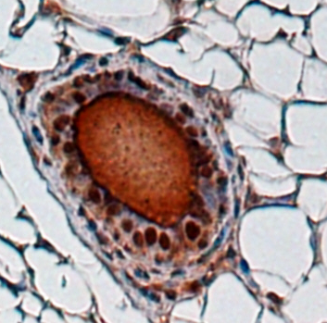
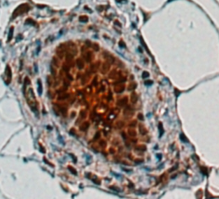
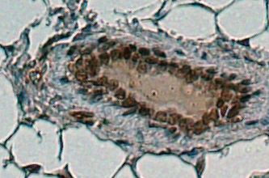
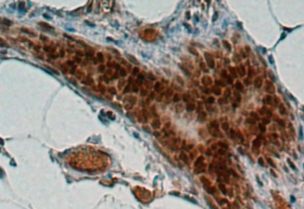
Supplementary Figure 2
A
Con
PELP1 Tg
Cyclin D1
B
Con
PELP1 Tg
^{Ser991}PELP1
Figure S2. Representative IHC images showing the status of cyclin D1 (A) and phos-PELP1 (B)in the mammary glands of 6-month-old control and MMTV-rtTA-TetO-PELP1 bitransgenic mice.

